Slide 1

PART I – Membrane Builder

Slide 2
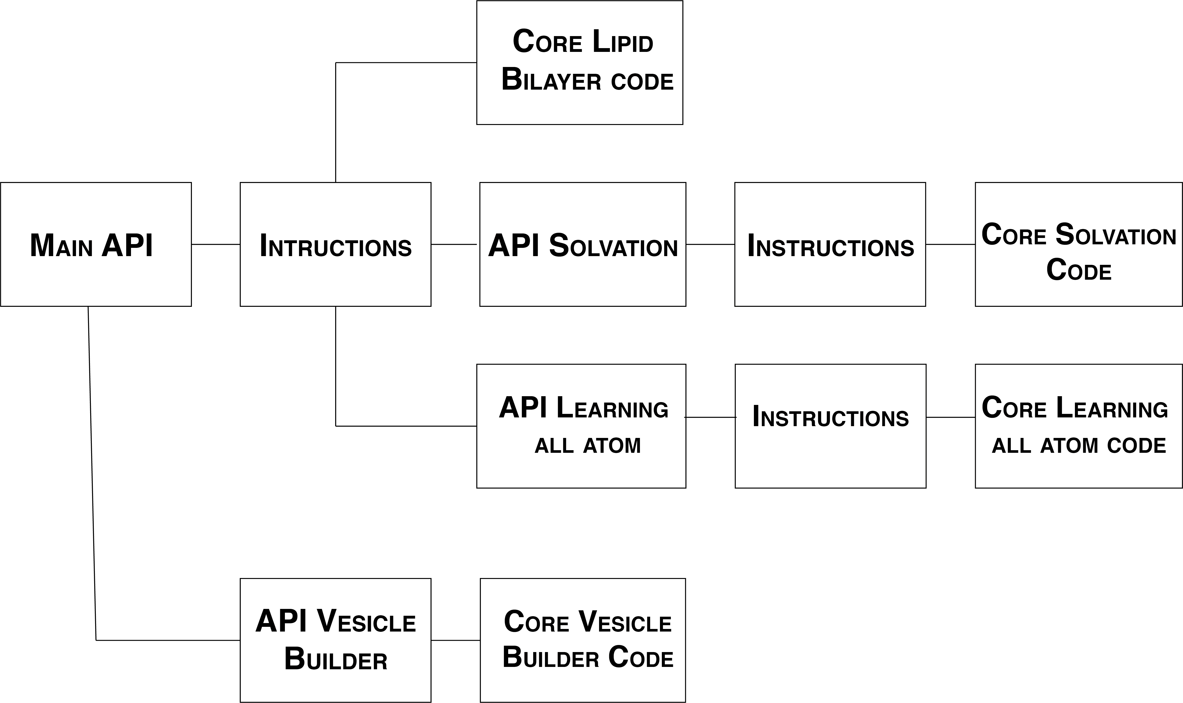
Code structure

Slide 3
Automatic Protein Insertion

Slide 4
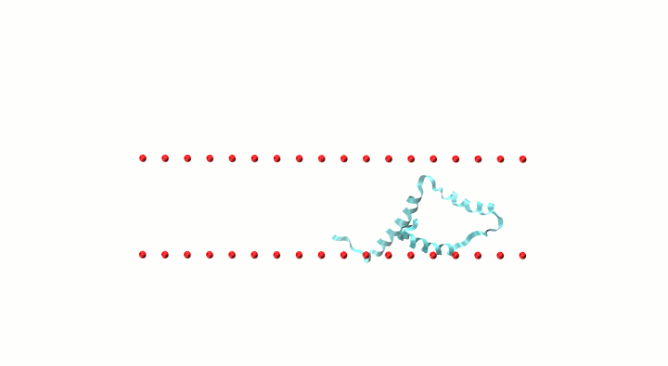
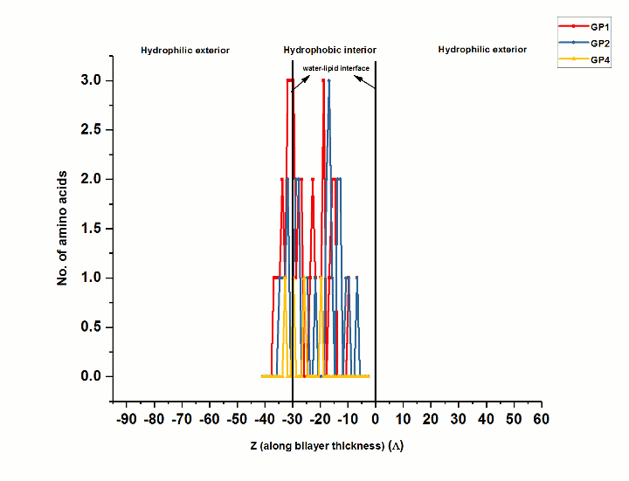
Algorithm
EXPLORING THE PHASE SPACE
AMINO ACIDS DISTRIBUTION
(GP1,GP2,GP4 are the different groups of amino acids)

Slide 5
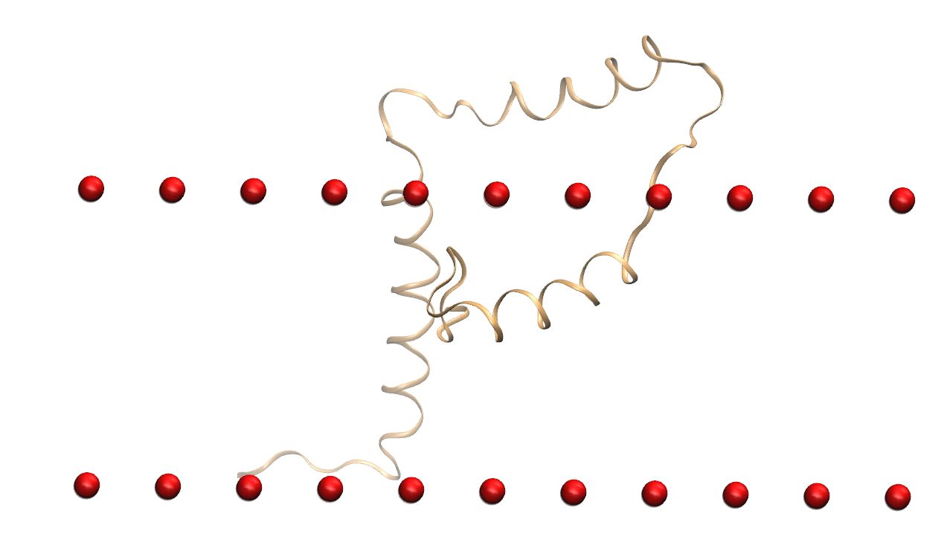
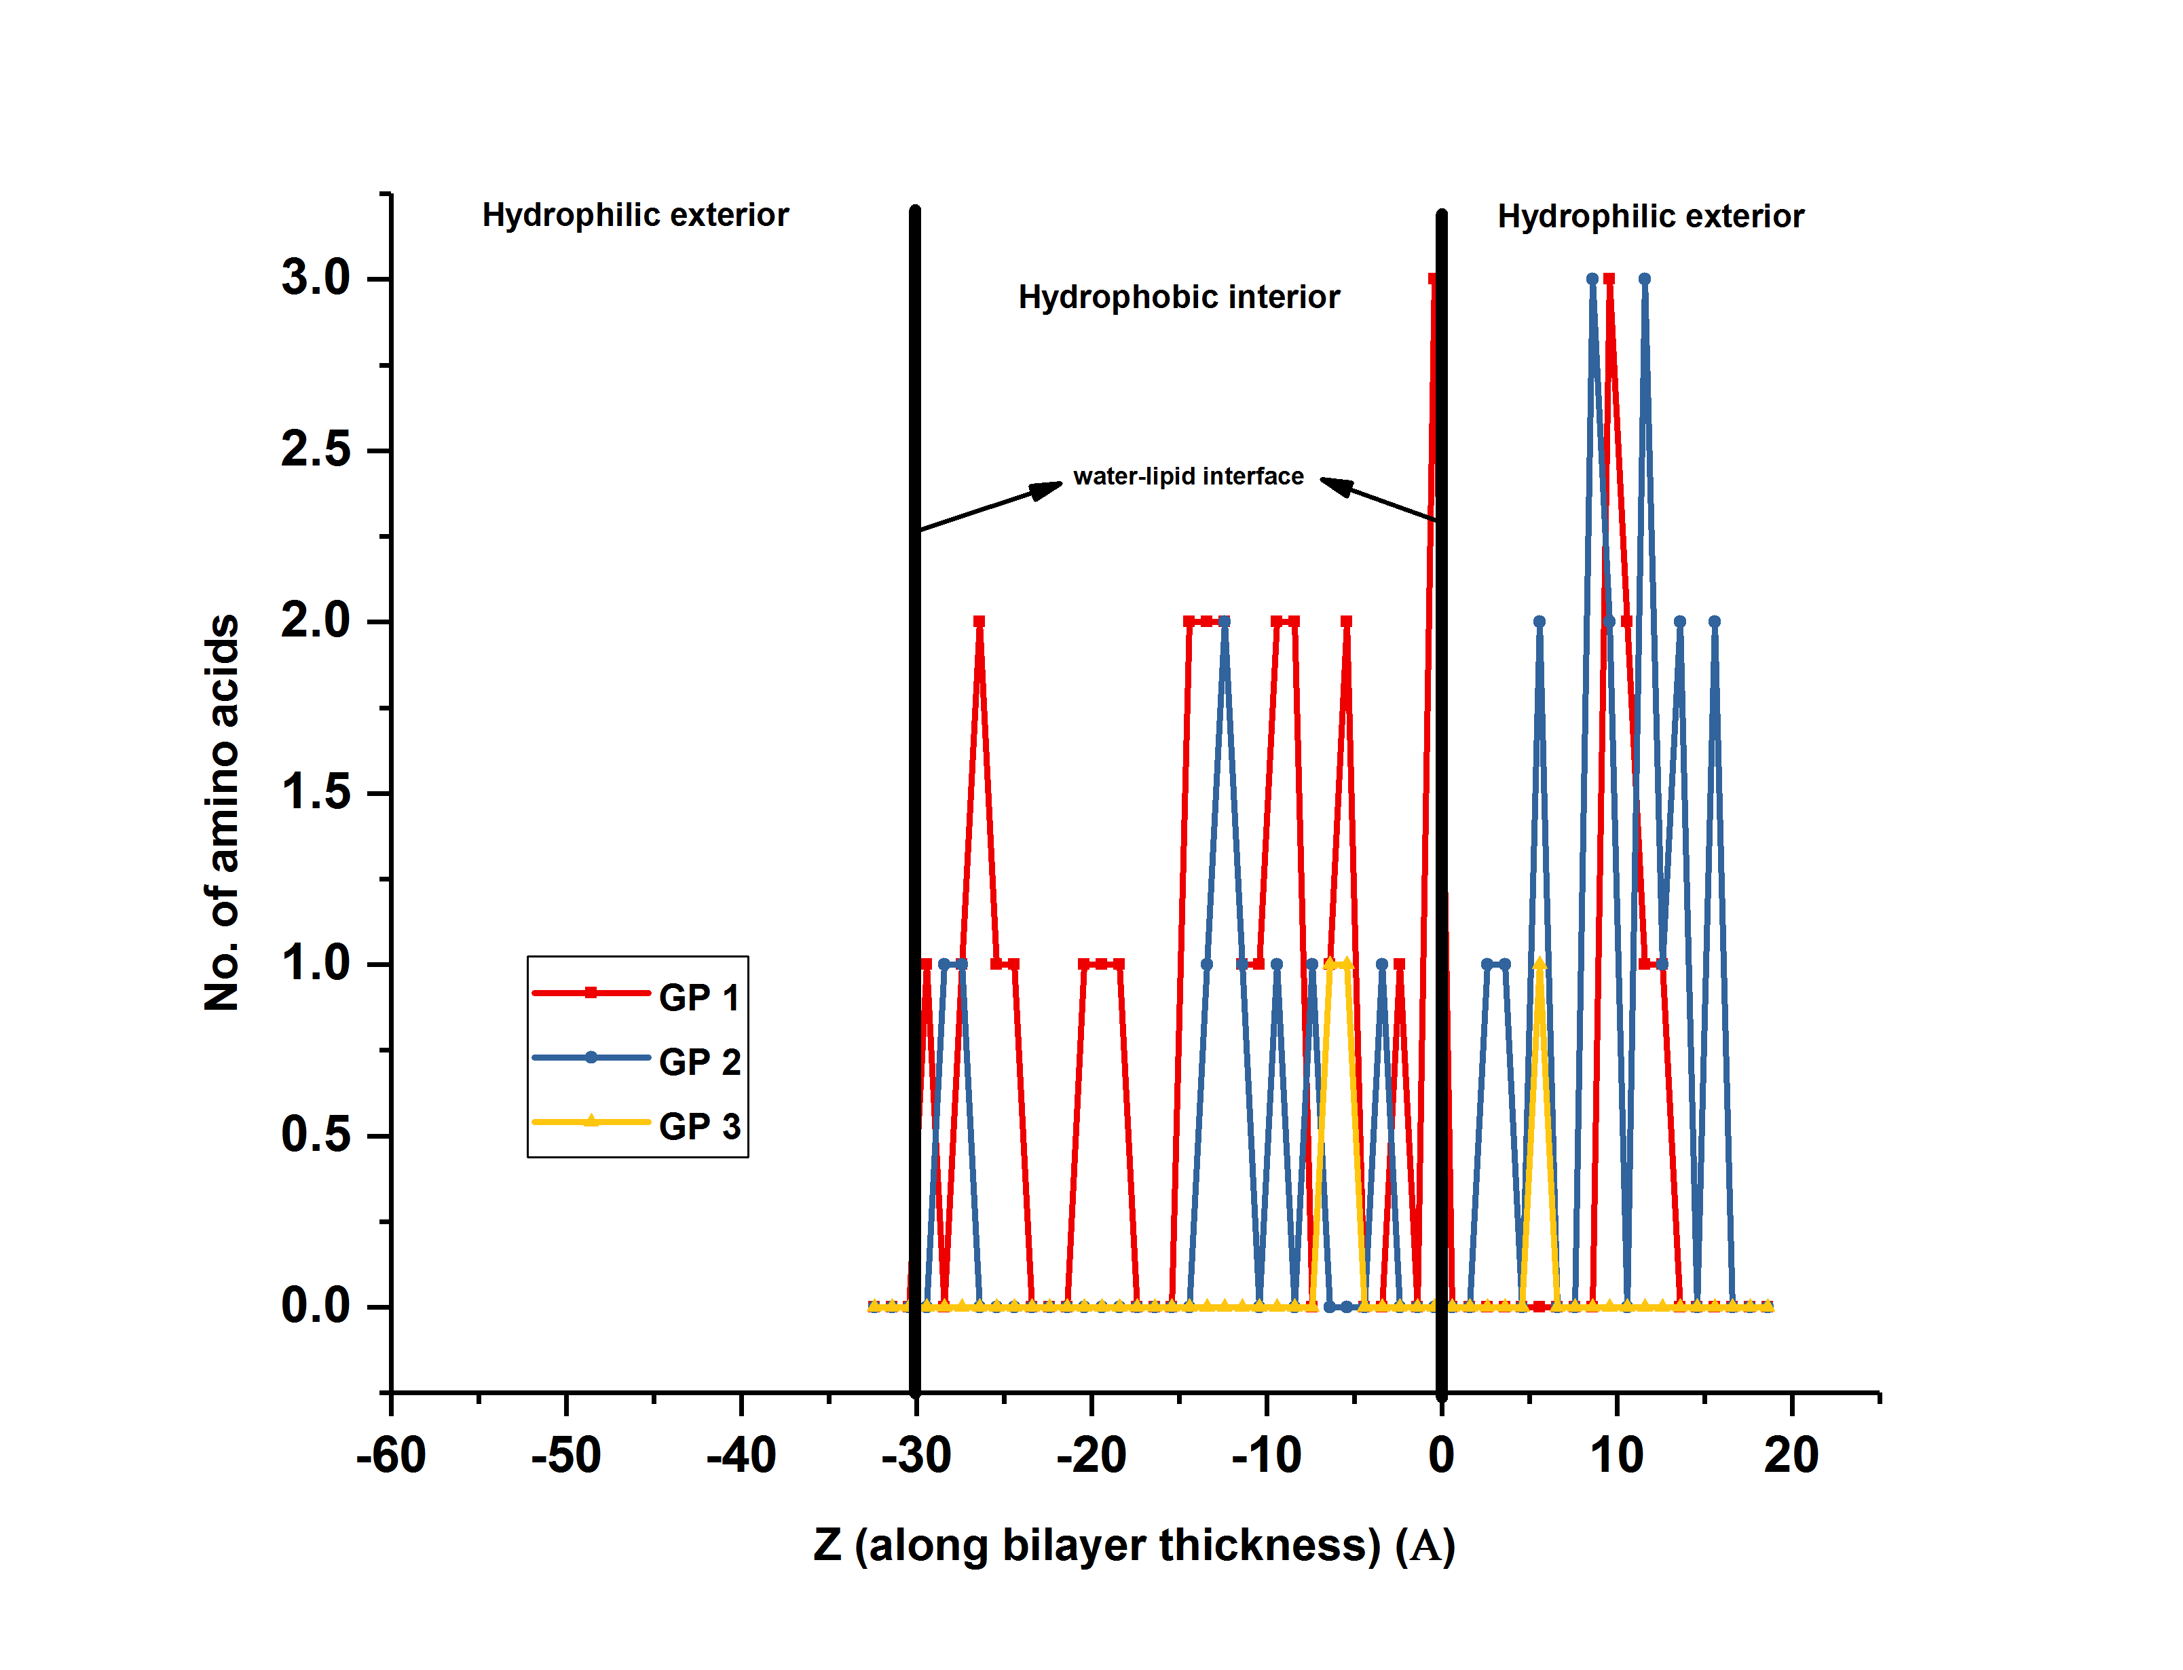
Final Profile for Viral Protein U (Vpu) (2n28)

Slide 6
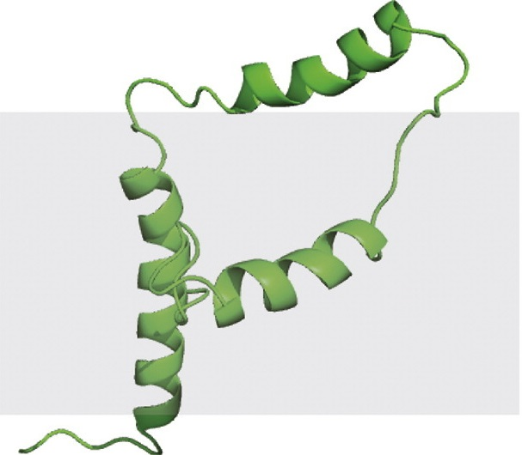
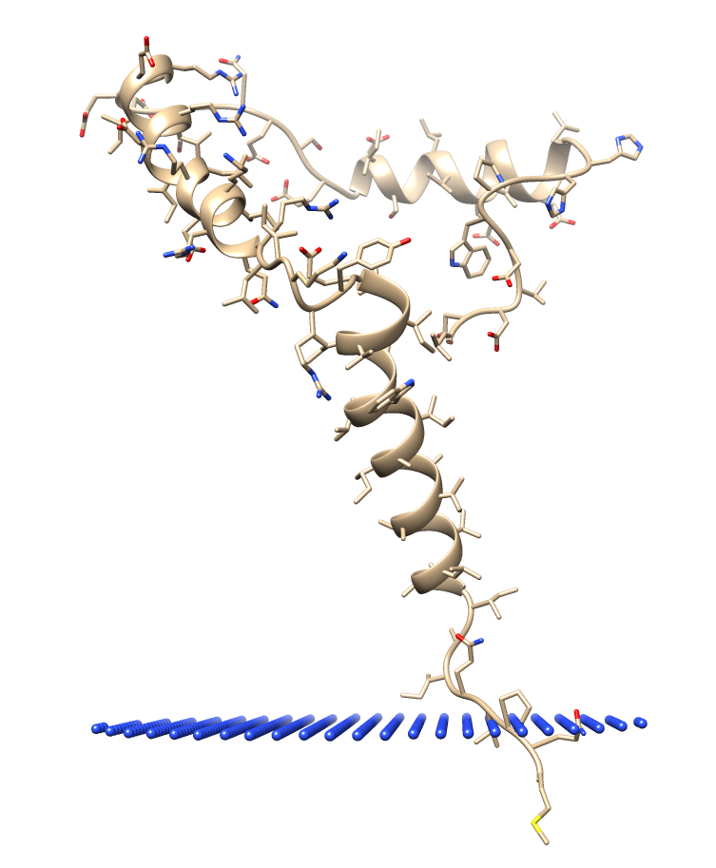
Correct Structure?
STRUCTURE FROM AMBAT
STRUCTURE FROM PPM SERVER (OPM DATABASE)
SOLID-STATE NMR STRUCTURE

Slide 7
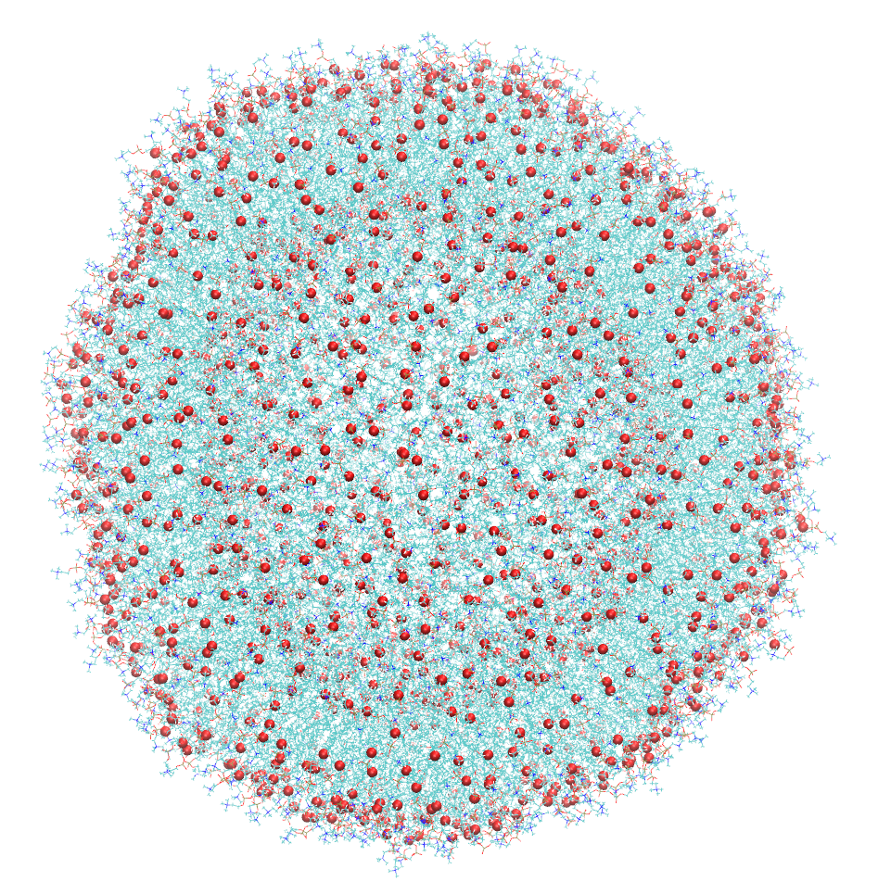
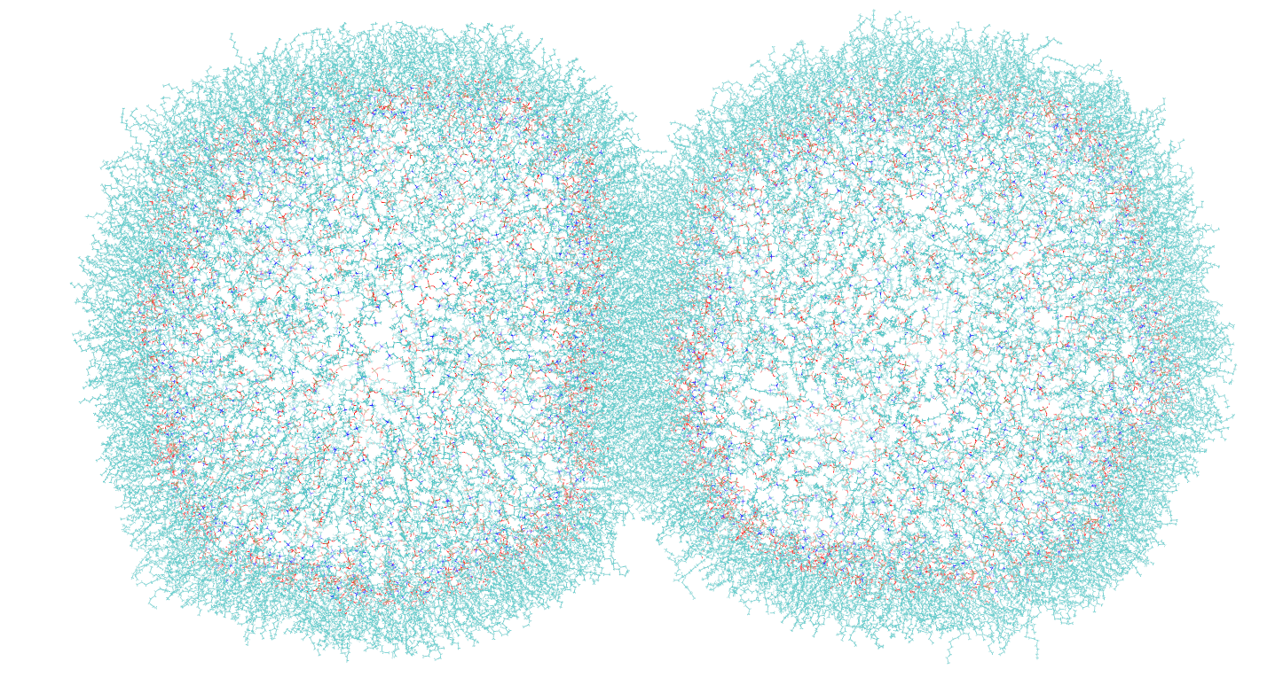
VESICLES AND DIBS

Slide 8
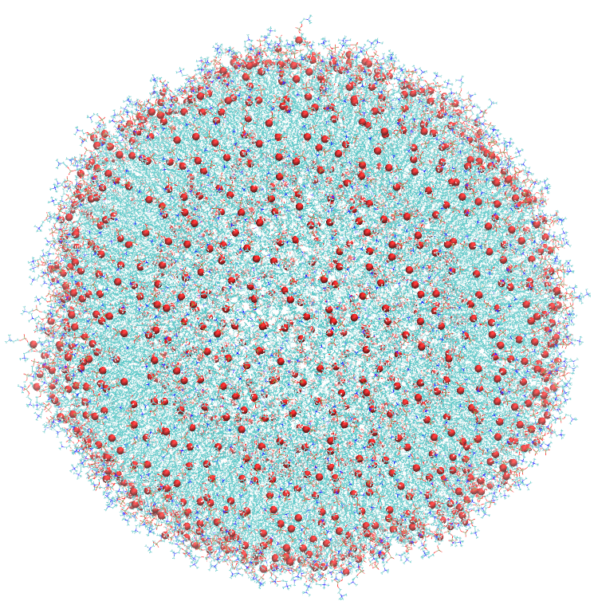
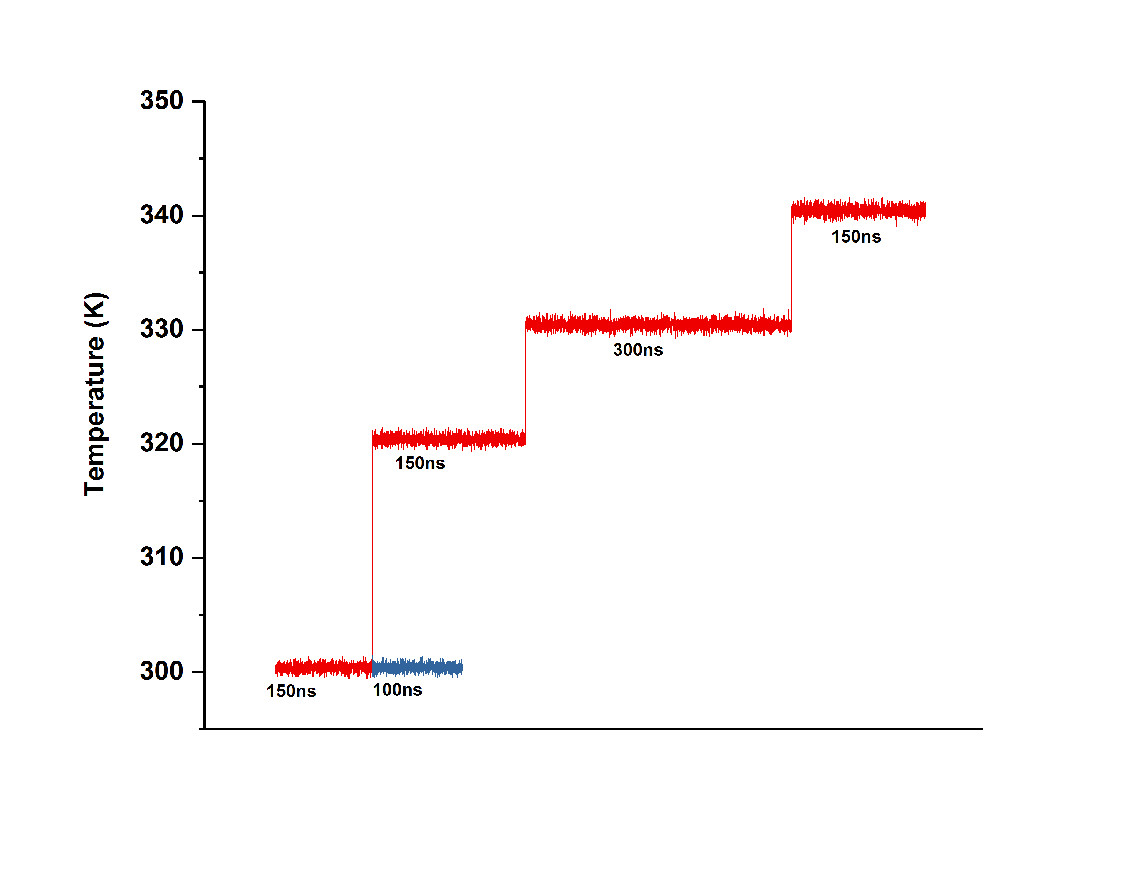
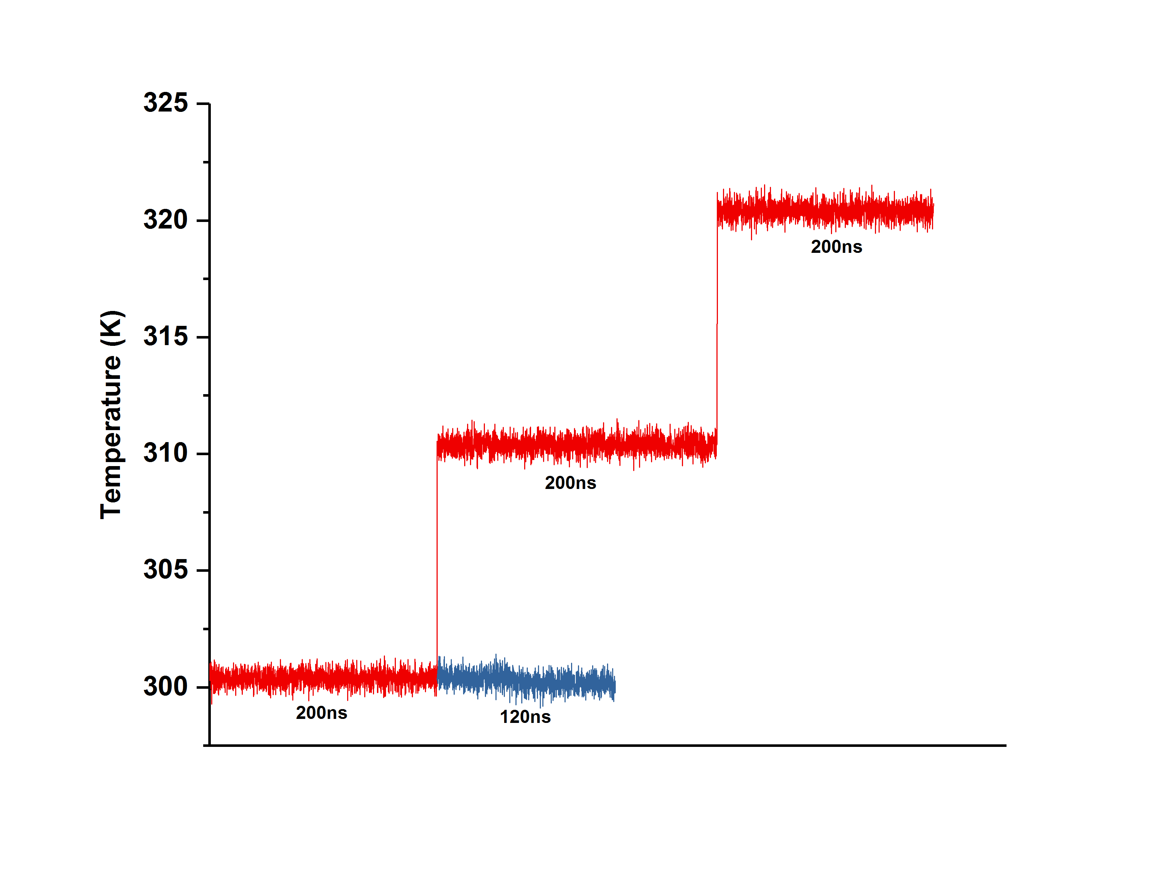
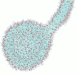
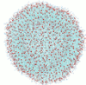
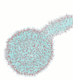
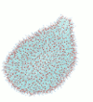
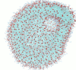
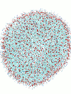
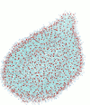
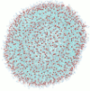
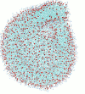
Vesicle with no internal pore
INITIAL SYSTEM
REPEAT 1
REPEAT 2

Slide 9
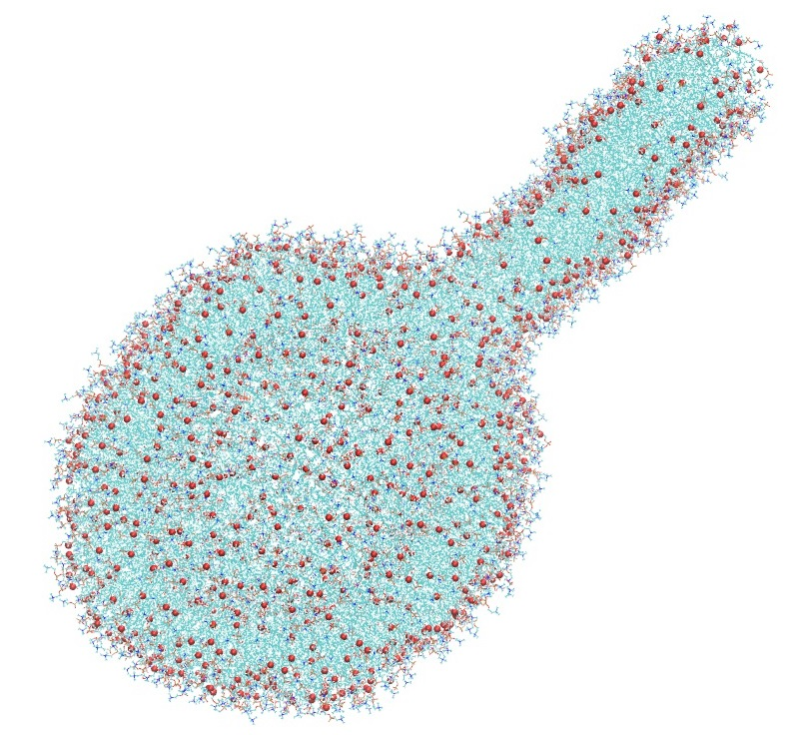
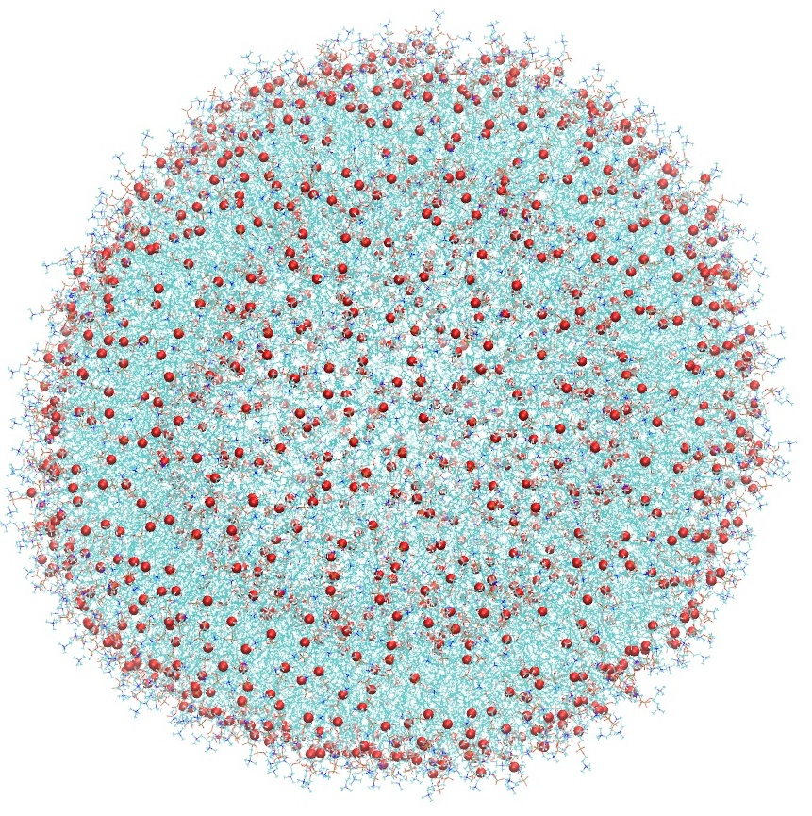
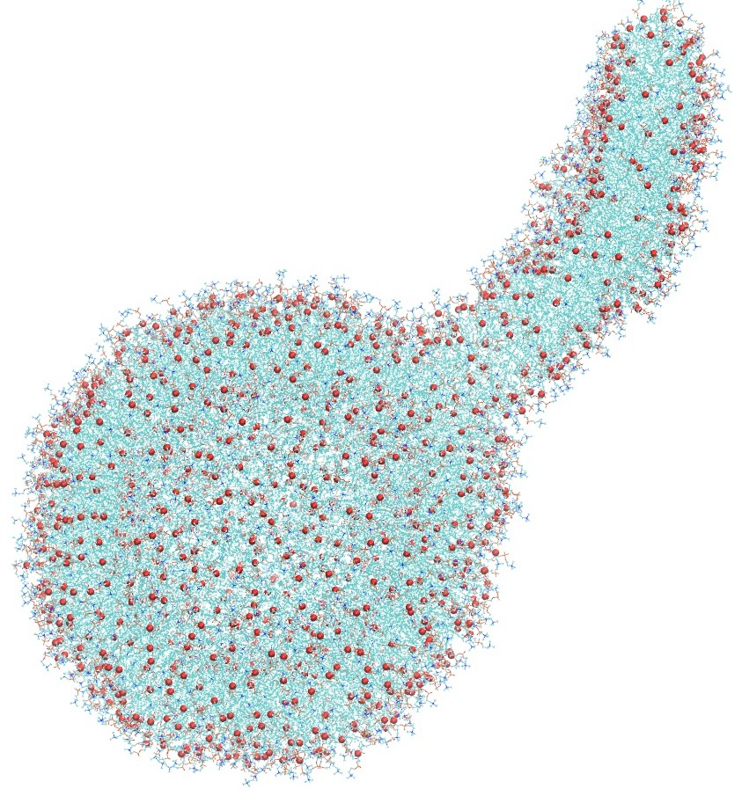
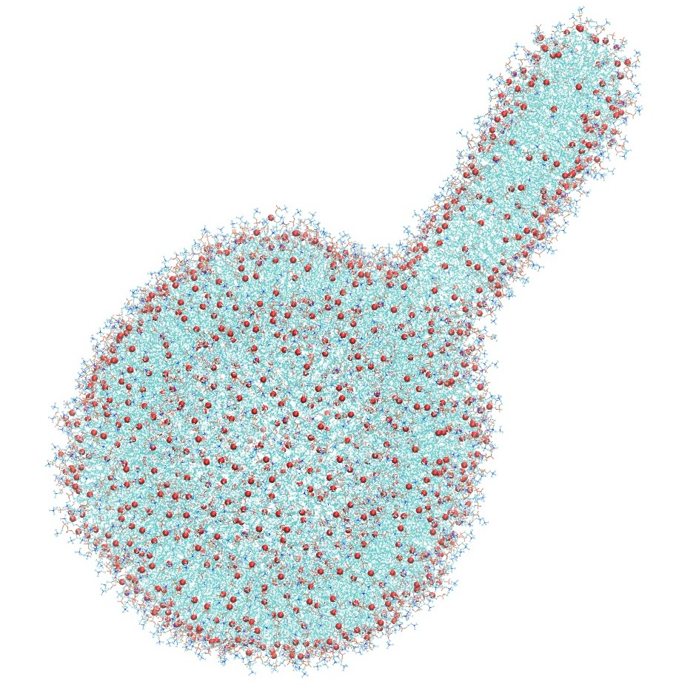
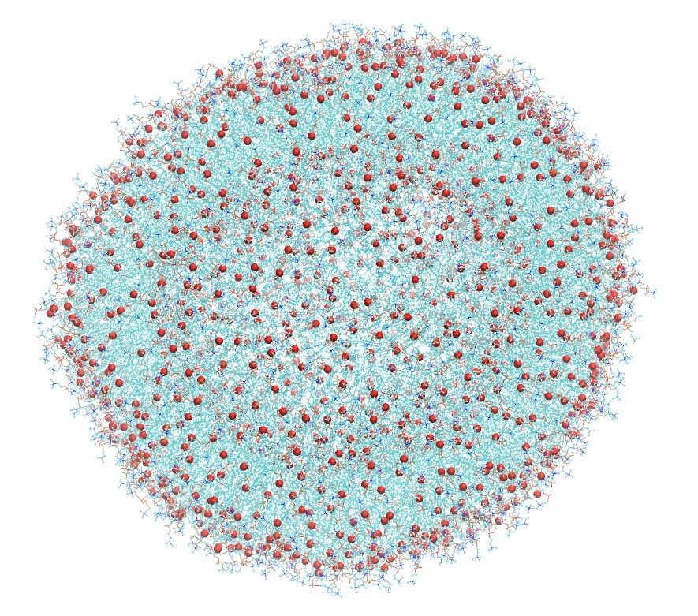
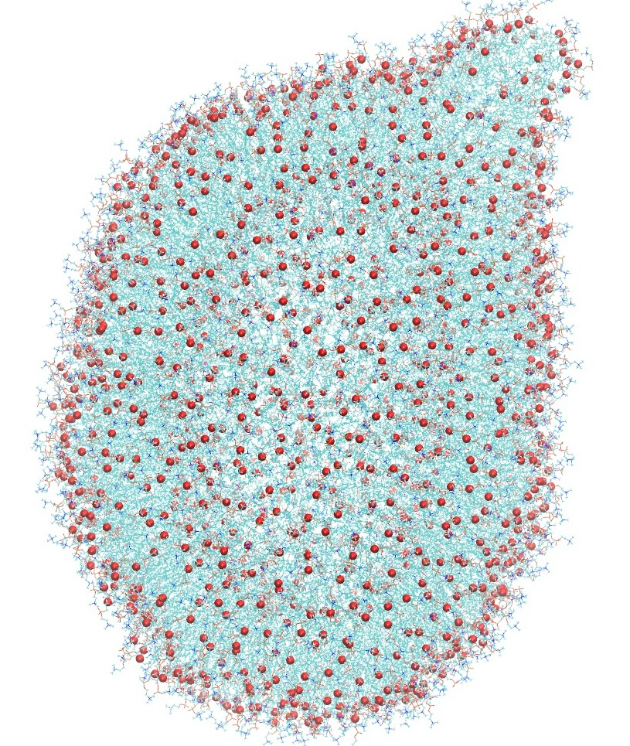
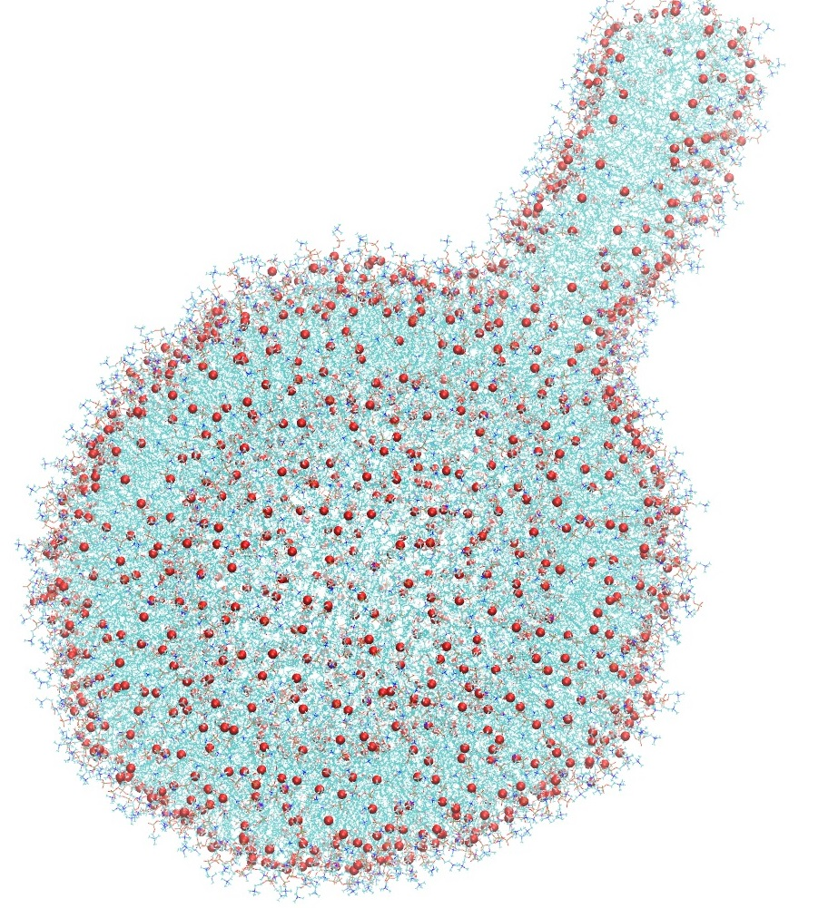
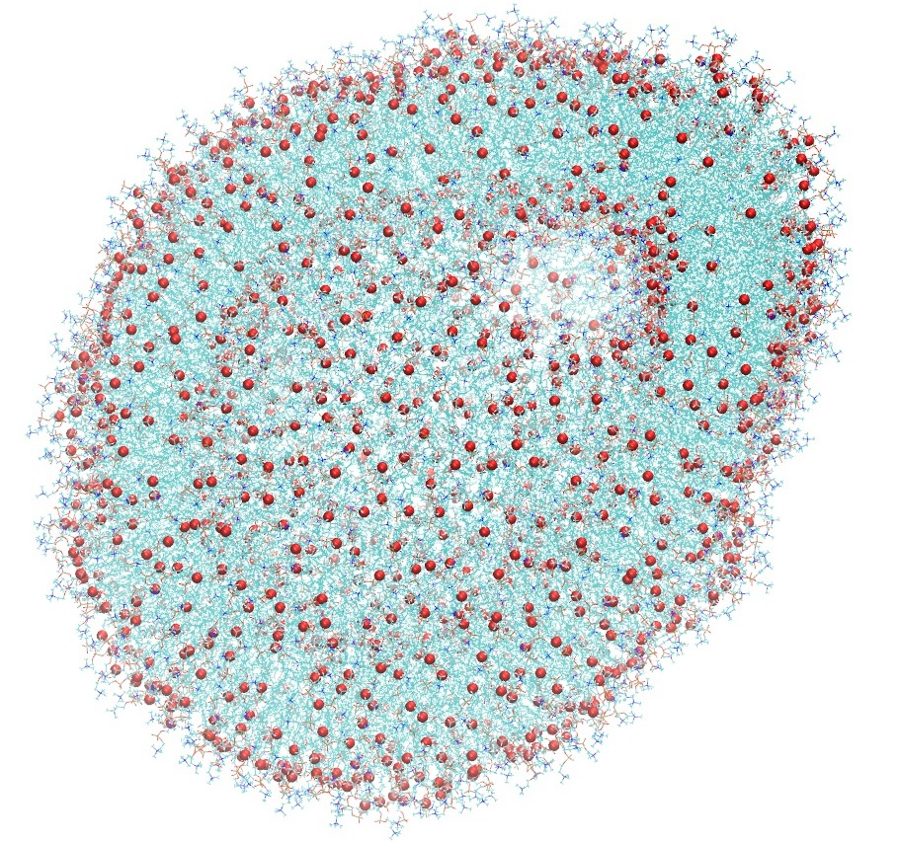
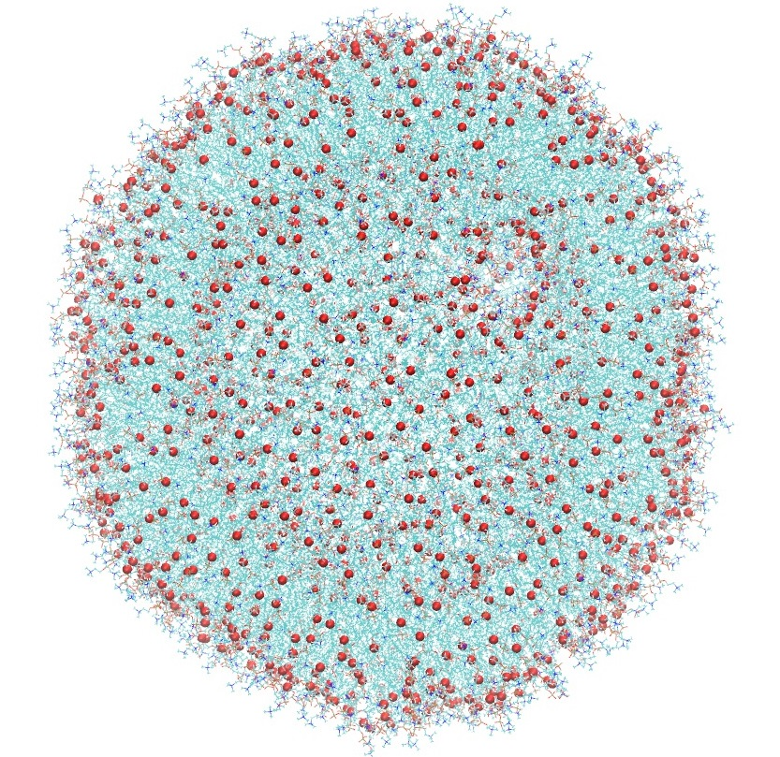
Vesicle with no internal pore
INITIAL SYSTEM
REPEAT 1
REPEAT 2

Slide 10
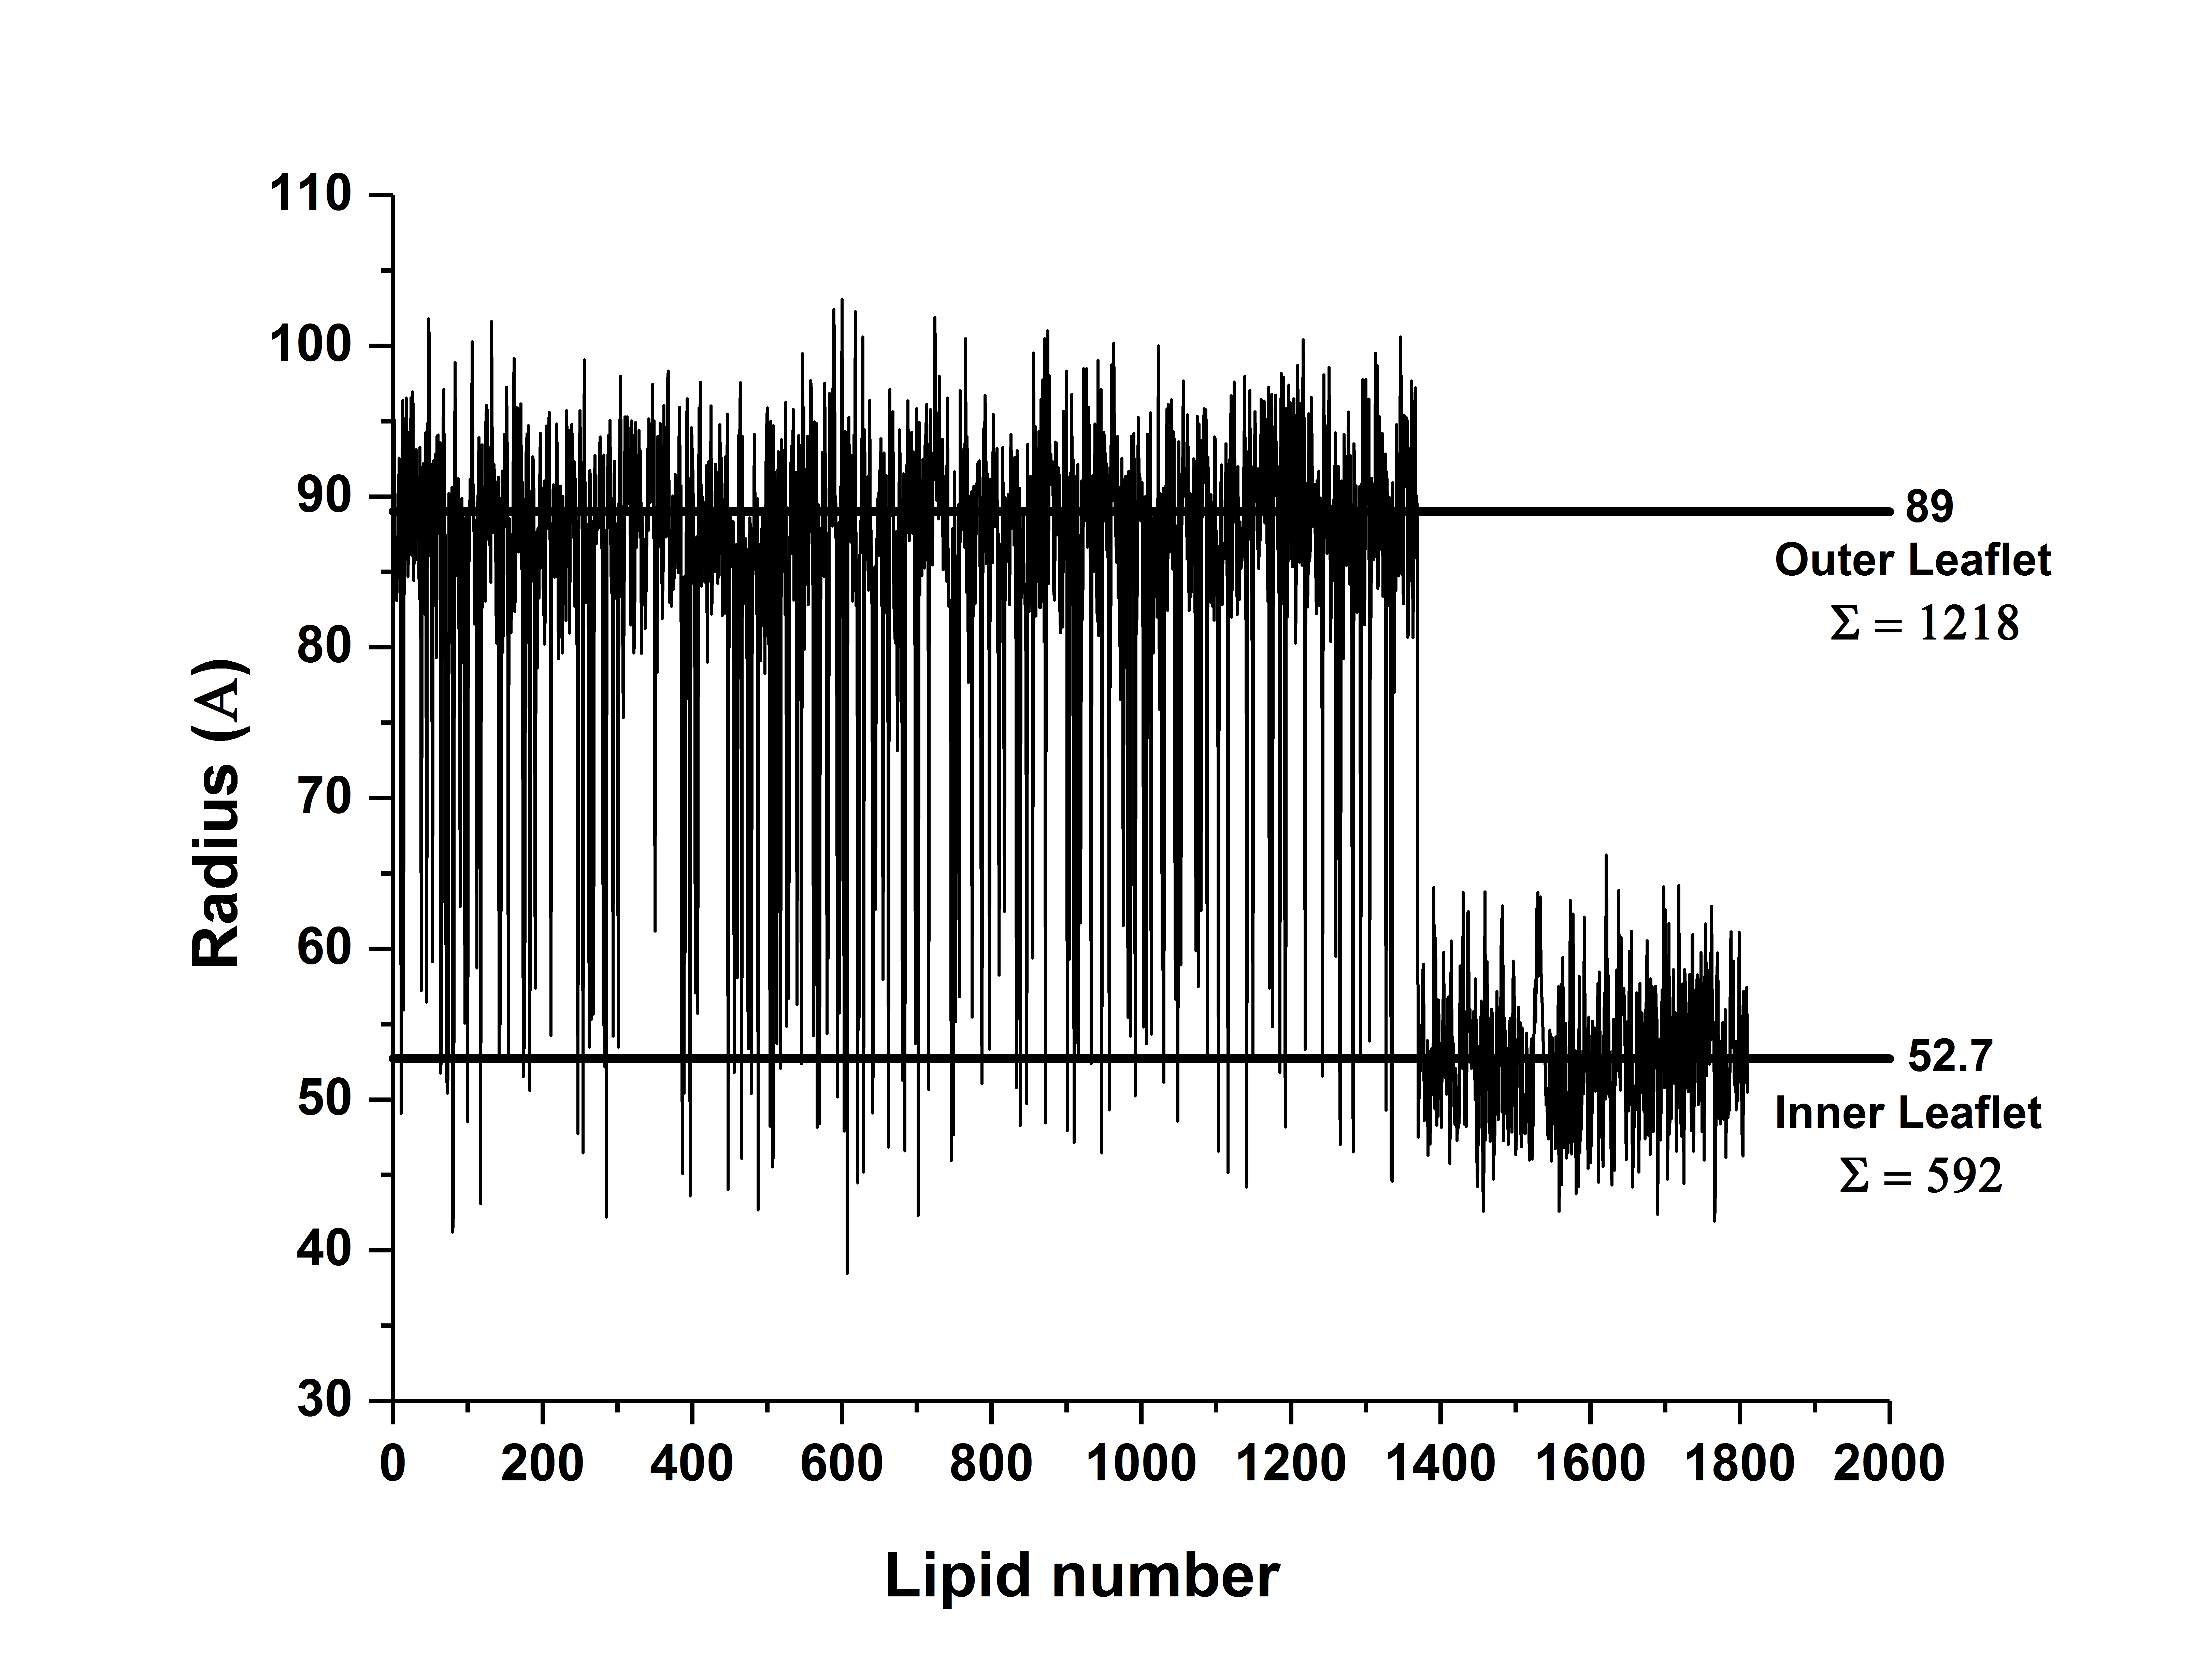
Vesicle with no internal pore
The concentration gradient between the inner and the outer leaflet results in the flipping of lipids from one leaflet to another.
The above phenomenon either results in lipid reduction (repeat1) or lipid redistribution between the leaflets (repeat 2).
The redistribution owing to maintaining the overall initial concentration of the system is the preferred phenomenon.
Closer inspection of repeat 2 shows the formation of water pores between the inner and the outer leaflet which facilitates the flipping of the lipids.
This forms the bases for the next system with the pores incorporated into the initial system.

Slide 11
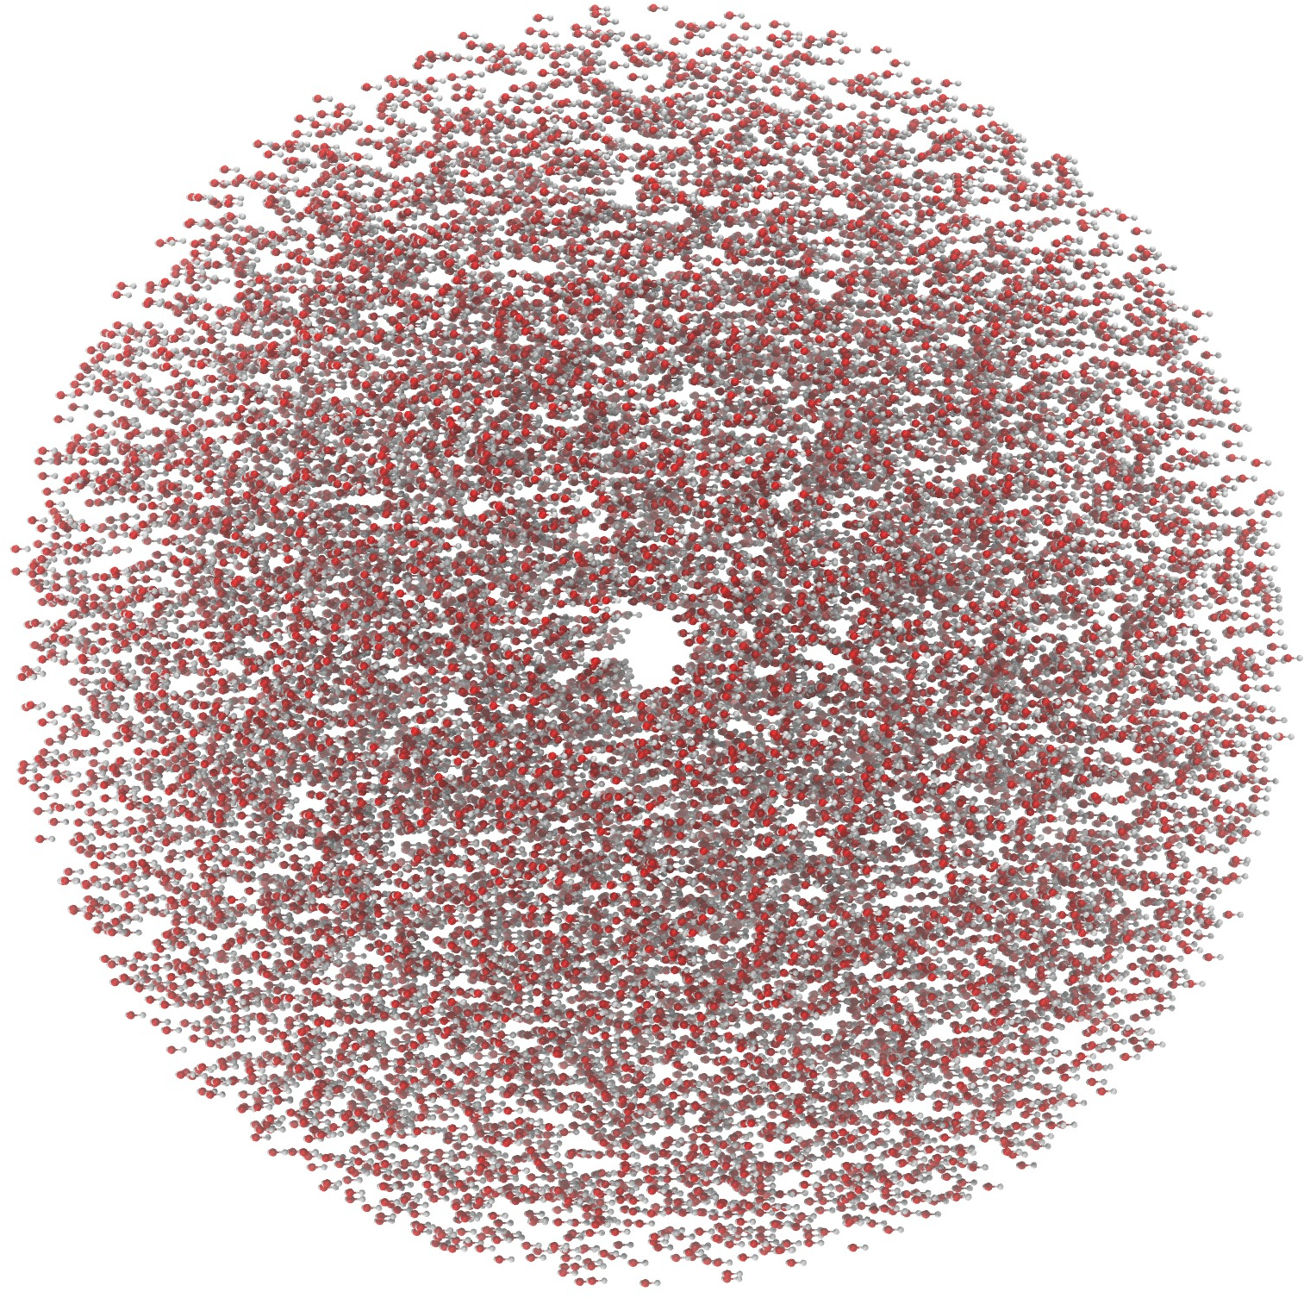
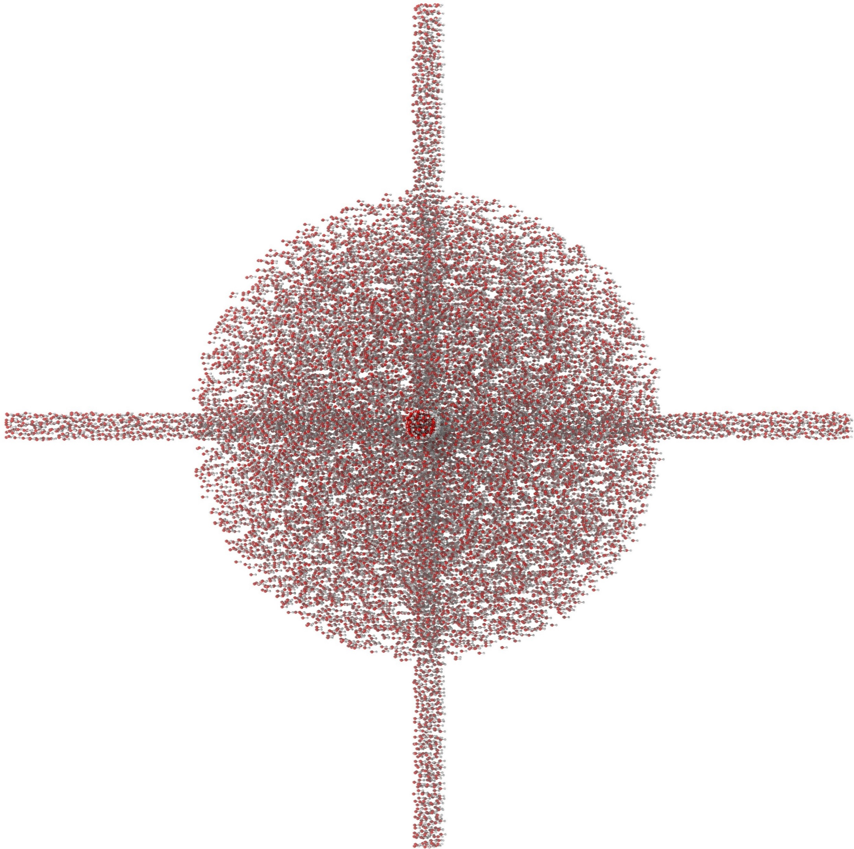
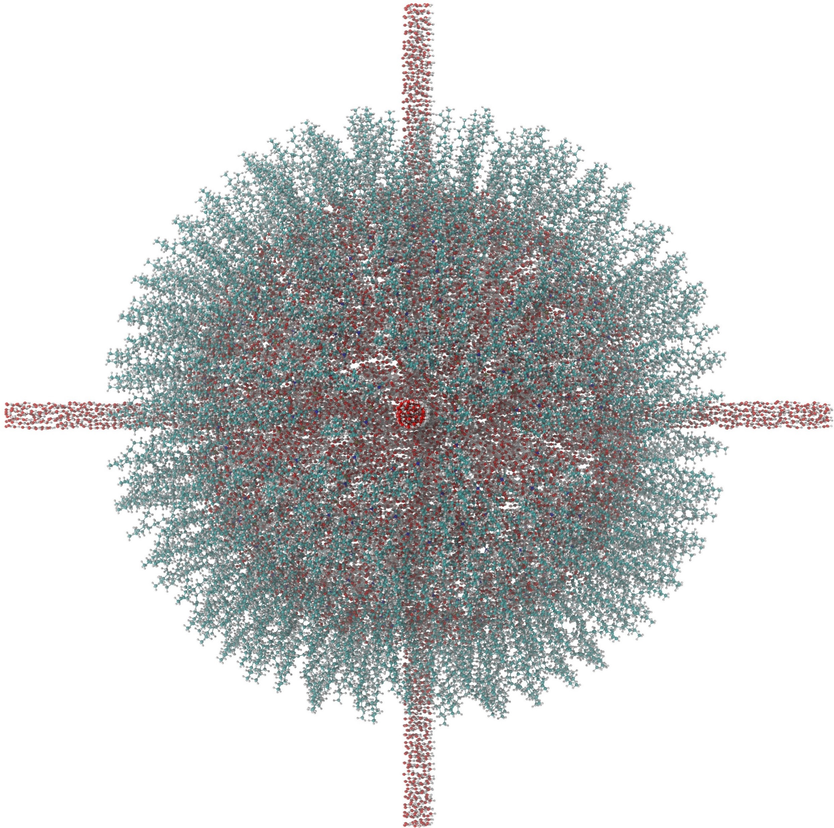
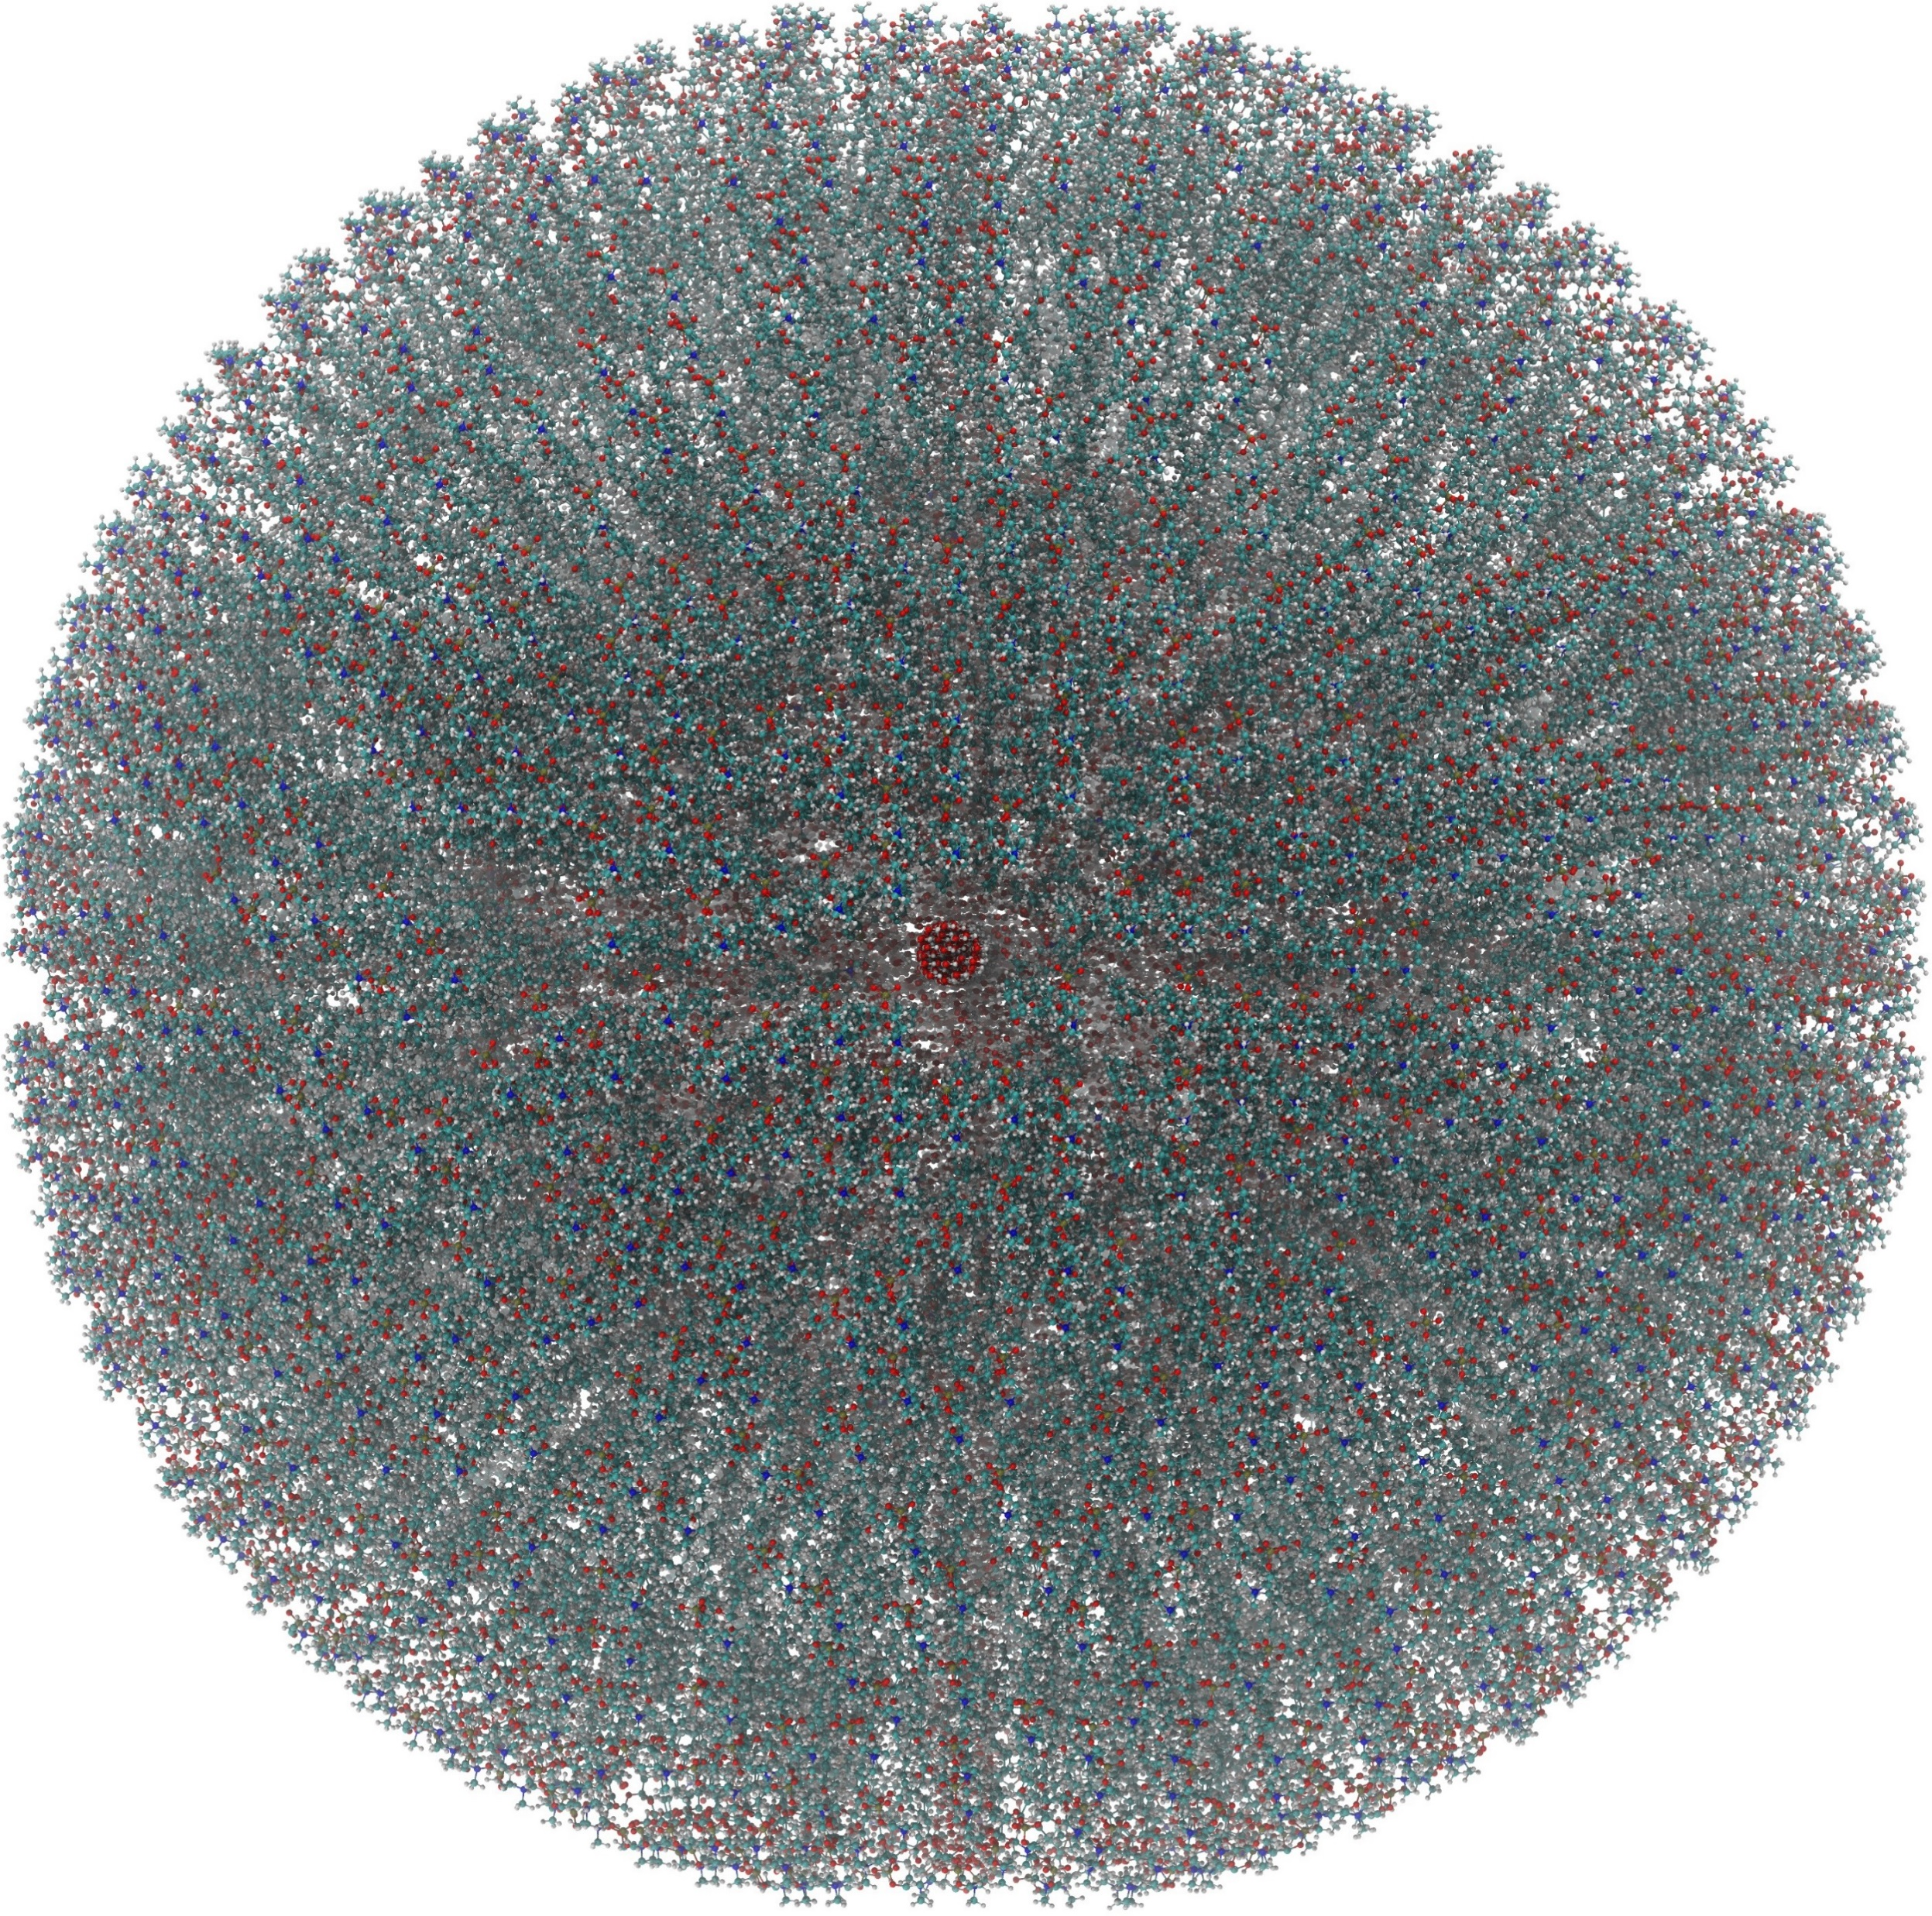
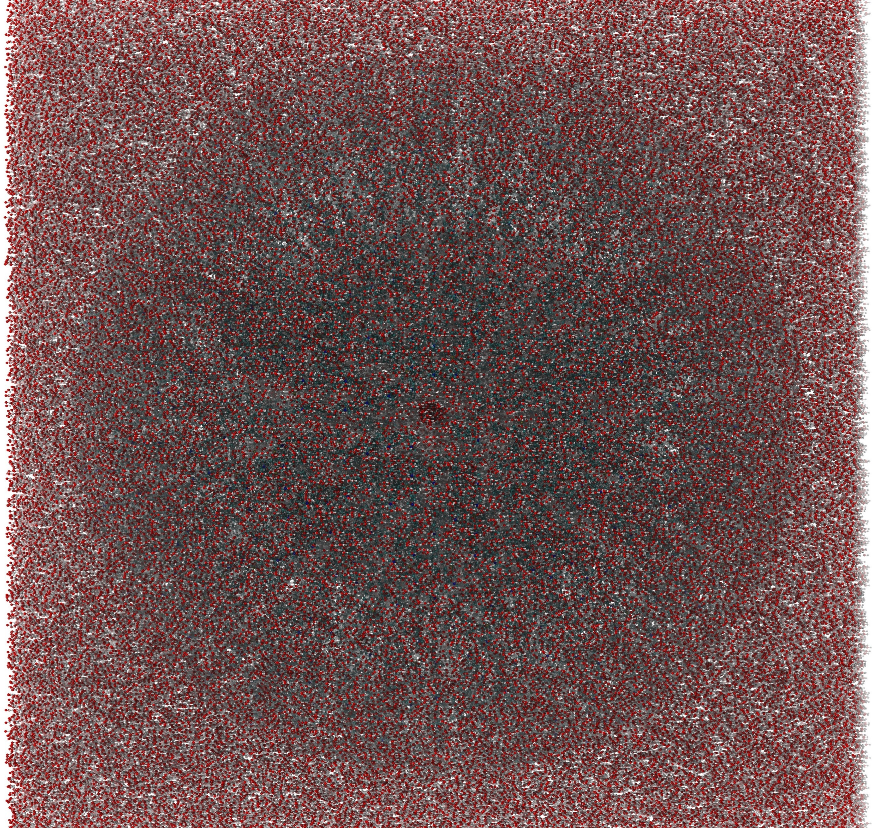
Vesicle with internal pore
Internal water
Water pores
Inner leaflet
Outer leaflet
External Water
(Final System)

